Slide 1
Project Proposal:
Project Name:
DIGITEYES

Slide 2
Introduction:
This software will extract a handwritten digit from an image and show it to the user as a digital format. The image can be black and white. Even the background color and the color in which the digit was written can be different.

Slide 3
Motivation :
When we label something using a digit it can be hard to ensure if we are keeping the right thing under the right label. Here I can automate the process and improve the accuracy and speed up the work.

Slide 4
Project Objectives:
1.Develop a efficient and accurate software for digit extraction.
2.Implement the software using command line tools.
3. To handle a variety of image types such as different background.

Slide 5
Features:
Edge Detection
This is useful for recognizing digits which has specific shapes.
Convolution
It can be used to extract edges, corners and texture from an image.
Grayscale Conversion
It can be used to simplify the image which makes it easier to analyze the image.
Image Resizing
It can help standardize the input size and aspect ratio of the image.

Slide 6
Knowledge:
Core Java
Image Processing
IDE(VS Code)
Language:
JAVA

Slide 7
Proposed Timeline
Tasks | April 1 | May 1 | June 1 | July 1
Proposal
Requirements
Learning & Designing
Coding
Final Testing
2
20
25
35
10
Duration of time

Slide 8
Challenges
Time Constraints
Algorithm Implementation
Handwriting Recognition

Slide 9
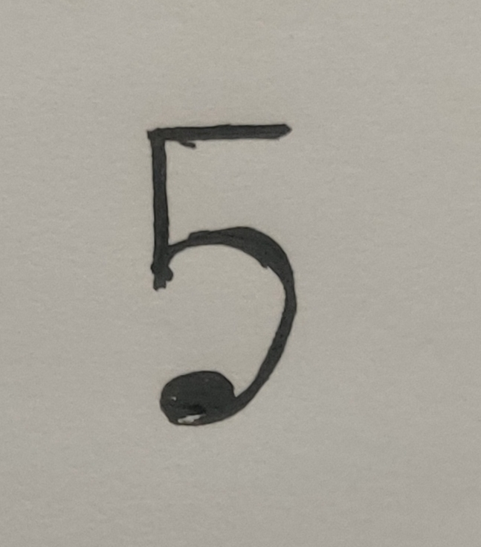
Sample Input:
Sample Output:
5

Slide 10
Deliverables
Source Code
Document
Jar File
User Manual

Slide 11


Slide 12


